Slide 1



SLIDE 1
CUSTOMER DATA ANALYSIS USING PYTHON
Name : Subasri Nandakumar
Student Number: 20079001
Module: Programming for Analytics (B9BA200)
Lecturer: Dr. Muhammad Alli

Slide 2


SLIDE 2
INTRODUCTION
The aim of this project is to analyse customer-related data using Python.
Customer data analysis helps organisations understand customer behaviour and usage patterns.
Python is used in this project to explore and visualise customer data.

Slide 3

SLIDE 3
DATASET
The dataset used in this project was obtained from a Data in Brief article.
Data in Brief is a peer-reviewed journal that provides datasets for academic research.
The dataset is survey-based and contains customer or service usage information.
A
B
C

Slide 4
TOOLS USED
SLIDE 4
Python Programming Language
Pandas for data loading and handling
Matplotlib for basic visualisation
Seaborn for advanced visualisation

Slide 5

SLIDE 5
DATA ANALYSIS PROCESS
The dataset was loaded into Python using Pandas.
Basic checks were performed to understand the structure of the data.
Graphs were created to analyse distributions and relationships in the data.

Slide 6
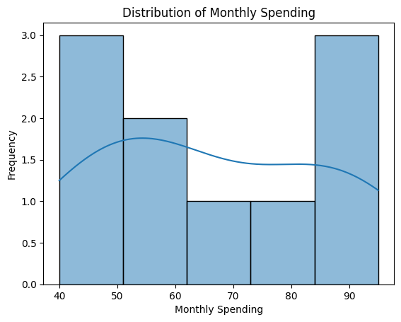
SLIDE 6
DISTRIBUTION OF DATA
This graph shows the distribution of monthly spending values.
It helps to understand how customer values are spread across different ranges.

Slide 7
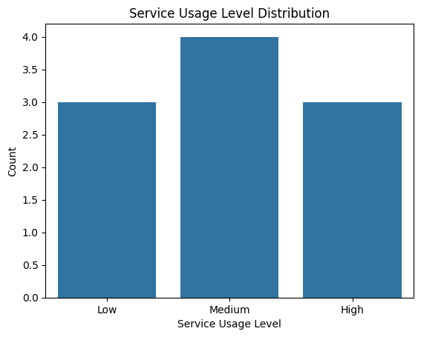

SLIDE 7
CATEGORY DISTRIBUTION
This graph shows the number of customers in each service usage category.
It helps to compare different customer groups.

Slide 8
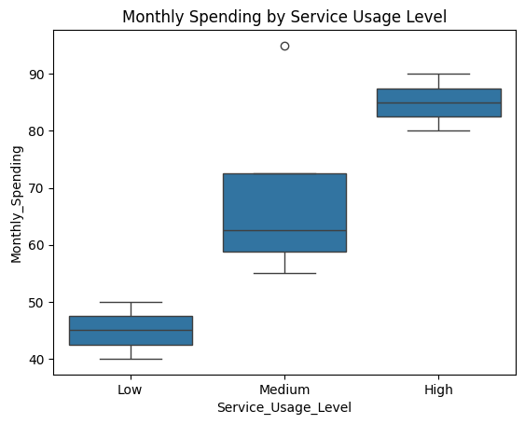
SLIDE 8
RELATIONSHIP BETWEEN VARIABLES
This graph compares monthly spending across service usage levels.
It shows variations in customer behaviour between categories.

Slide 9
KEY FINDINGS
SLIDE 9
Customer values are not evenly distributed across the dataset.
Service usage level influences monthly spending.
Data visualisation helps identify patterns clearly.

Slide 10


SLIDE 10
CONCLUSION
This project demonstrated customer data analysis using Python.
Python libraries helped in data exploration and visualisation.
The project improved understanding of practical data analysis techniques.
THANK
YOU!

